Slide 1

BRICS and Beyond: Exploring the Emerging Economies
The BRICS nations - Brazil, Russia, India, China, and South Africa - have emerged as key players in the global economy, driving innovation and reshaping the international landscape. This presentation explores the history, opportunities, and future of this dynamic economic bloc.

Slide 2
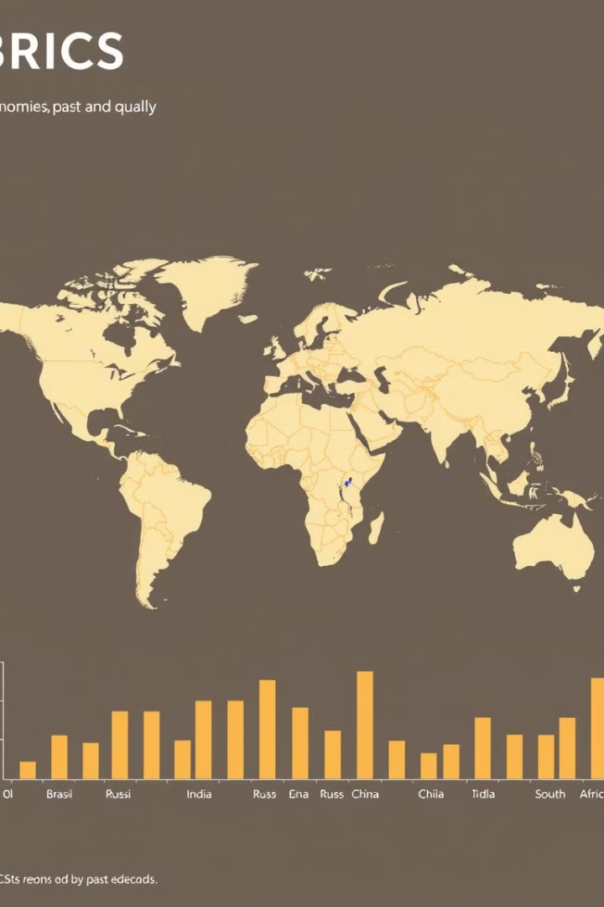
What is BRICS? A Brief History and Overview
1
Origins
The BRICS concept was first coined in 2001 by economist Jim O'Neill, who identified the potential of these rapidly growing economies.
2
Formal Establishment
The BRICS group was formally established in 2009 as a platform for the five major emerging economies to coordinate on global issues.
3
Expanding Cooperation
Over the years, BRICS has evolved, focusing on areas like finance, trade, and sustainable development.

Slide 3
The BRICS Countries: Brazil, Russia, India, China, and South Africa
Brazil
Russia
India
A resource-rich nation with a large domestic market and a focus on agriculture, energy, and manufacturing.
A global energy superpower with a strong industrial base and a growing high-tech sector.
A rapidly growing economy with a young population, a thriving IT industry, and a focus on sustainable development.

Slide 4
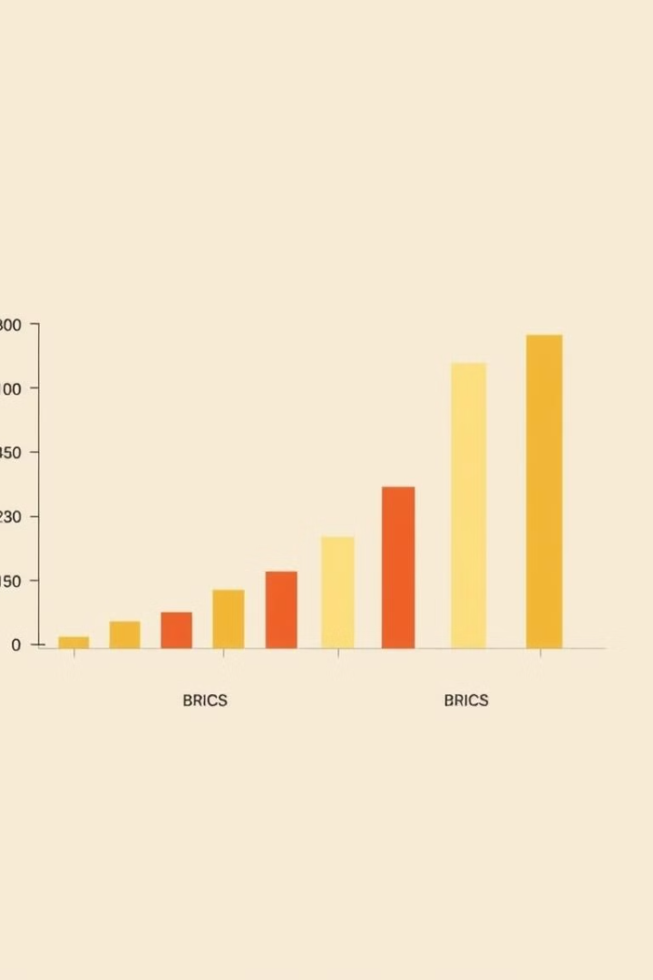
The Emergence of a New Economic Powerhouse: The BRICS Bloc
1
Increasing Economic Clout
2
Diversified Economies
The BRICS countries cover a wide range of industries, from agriculture and manufacturing to technology and financial services.
The BRICS nations have experienced rapid economic growth, collectively accounting for over 40% of the global population and a significant share of the world's GDP.
3
Geopolitical Influence
The BRICS bloc has emerged as a counterweight to traditional Western powers, challenging the global order and advocating for reform of international institutions.

Slide 5
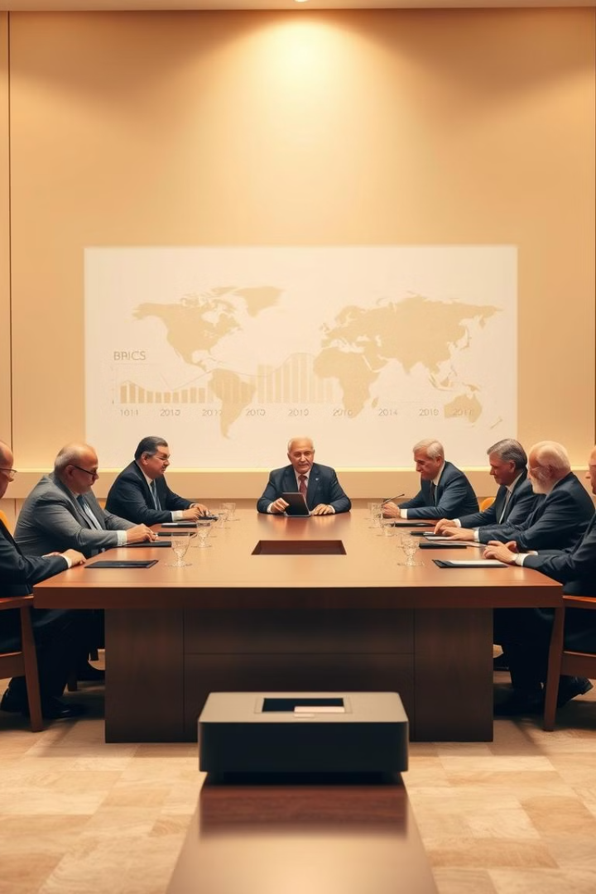
Opportunities and Challenges Facing the BRICS Nations
Opportunities
Challenges
Continued economic growth, expanding middle class, investment in infrastructure, and increased trade and investment within the BRICS bloc.
Addressing income inequality, corruption, environmental degradation, and the need for political and institutional reforms in some BRICS countries.
Cooperation
Global Integration
Strengthening intra-BRICS cooperation in areas like finance, technology, and sustainable development to harness the group's collective potential.
Balancing the BRICS' desire for a greater voice in global governance with the need for deeper integration into the international system.

Slide 6
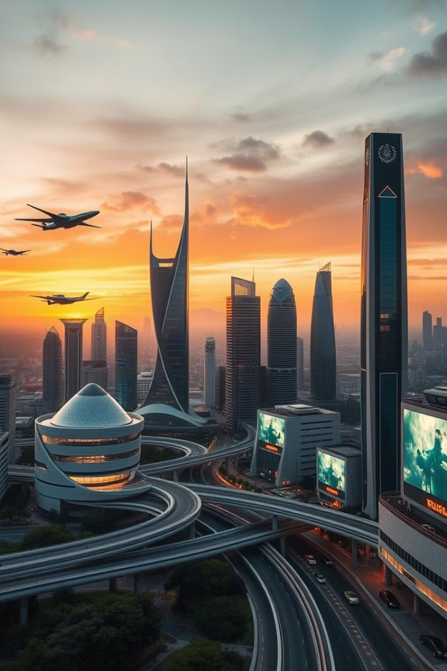




The Future of BRICS: Expanding Horizons and New Frontiers
Innovation
Global Cooperation
Leveraging emerging technologies to drive sustainable and inclusive growth.
Strengthening BRICS' role in shaping the global economic and political agenda.
Sustainable Development
Expanding Membership
Prioritizing environmental protection and social equity in the BRICS development model.
Exploring the potential for BRICS to include new members and become a more inclusive platform.

